Slide 1
Optimizing Study Management using Automation and REDCap
Thomas Wilson, Will Beasley, David Bard CCAN Pediatrics
R21HIV-RFBS Project Design
November 21, 2013

Slide 2
Presentation Outline
REDCap Overview
Scenarios Favoring REDCap
Reports for Project Management
Reports for Outcomes
Overall Goals
Document Version Control
Security Practices

Slide 3
Collaboration among
The 4 statisticians on the project. sharing software development.
The 20 people on the project. exchanging participant-level data.
The 3 partnering organizations. (OSDH, WIC, OHCA) -receiving their subject-level & agency-level data. -distributing our results –fresh & frequently.
Academics in different areas. (particularly at OUHSC) exchanging tools and workflows.
Researchers in other states pursuing similar goals. publishing ideas and replicating previous work.

Slide 4
REDCap overview (http://project-redcap.org/)
Secure web application for building and managing surveys and databases.
Developed by informatics core at Vanderbilt with support from NCRR and NIH.
Designed for academic biomedical researchers.
Provides:
A centralized, back-end storage component.
Tools to create an interactive front-end html GUI.
An API to import & export data.
Example templates.
Instructional videos for training.
User-group network of institutional researchers.
Also included: built-in project calendar, scheduling module, ad hoc reporting tools, and advanced features, such as branching logic, file uploading, and calculated fields.
It can reduce
Developing a lot of new software applications.
Anxieties related to security of home-grown software.

Slide 5
REDCap Software Features
Availability - Software available at no cost for REDCap partners.
Secure and web-based - Input data or build online survey anywhere in the world over secure web connection with authentication and data logging.
Multi-site access - REDCap databases/surveys can be used by researchers from multiple sites and institutions.

Slide 6
REDCap Software Features Cont.
Fast and Flexible - Conception to production-level database or survey is possible in less than a day.
Export Data in Common Formats - REDCap automatically exports data in the following formats: Excel CSV, SAS, Stata, R, and SPSS.
Fully Customizable - REDCap has the flexibility to allow total control of shaping a database or survey.

Slide 7
REDCap Project Types
https://miechvprojects.ouhsc.edu/redcap/index.php?action=training
Traditional Project classic model with data entry forms
Single Survey Project utilizes only one data collection instrument
Longitudinal Project multi-use data entry forms with abstract time points
Longitudinal Project + Scheduling multi-use data forms with defined time points
Operations use case for non-study/non-trial

Slide 8
REDCap Data Collection Instruments
REDCap utilizes two types of data collection instruments.
Data Entry Form – Data is entered by authorized REDCap project users. REDCap log0in access and project rights are required to view and edit the data entry forms.
Survey – Data is collected directly from participants. Participants will access questions via a secure webpage. No authentication is needed.

Slide 9
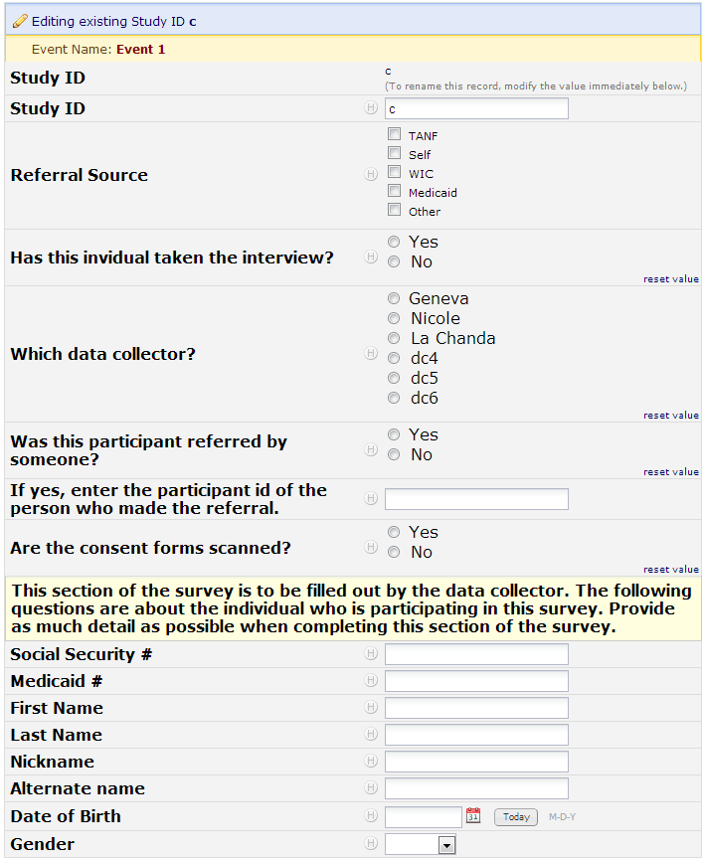
Example Data Entry
Example of data entry utilizing a REDCap data entry form.

Slide 10
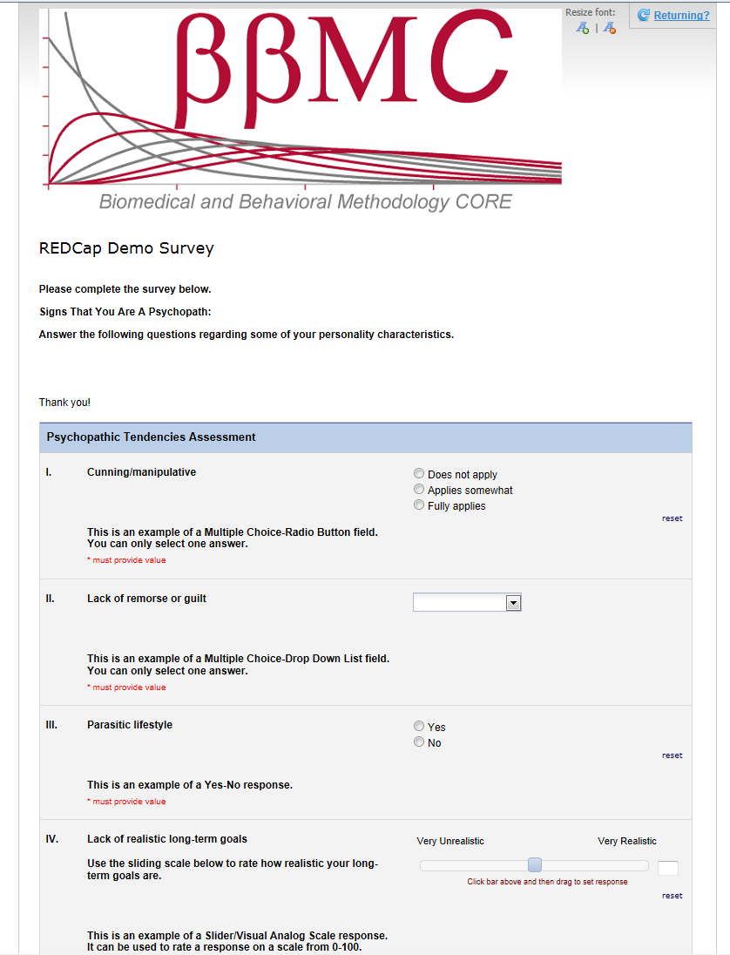
Example Data Entry
Example of data entry utilizing a REDCap survey.

Slide 11
Data Entry Demonstration
https://miechvprojects.ouhsc.edu/

Slide 12
Possible REDCap Workflows

Slide 13
Scenarios Favoring REDCap
Project requires a centralized data store, but multiple locations for data entry. - Avoid syncing different locations manually.
You want a flexible, universal framework to create consistent data systems for multiple clinical projects (research and possibly operations). - Reduces your development time & your staff’s training time. - Reduces writing new text for grant proposals and IRB?
Project has a relatively flat data structure.
Typically accommodates 2 or 3 levels well, but is clumsy beyond that. County, Practice, Provider, Patient, Time, Family.

Slide 14
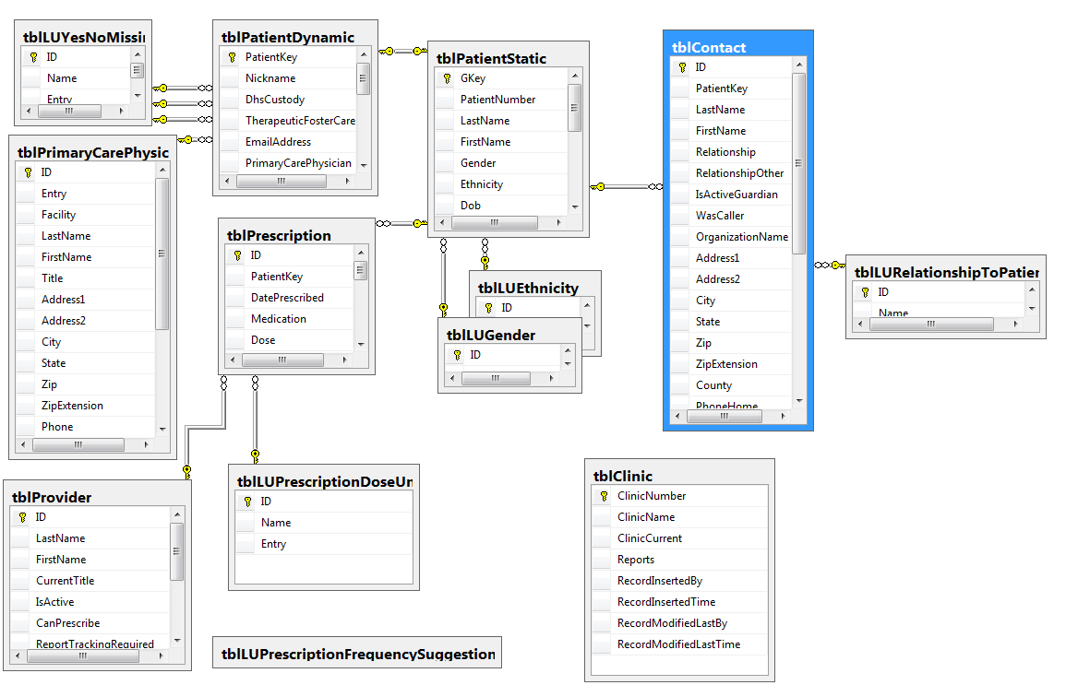
Scenario NOT favoring REDCap

Slide 15
Scenarios Favoring REDCap
No professional software developer on the project
There’s nothing magical about REDCap; it accommodates the designs and needs of many clinical projects.
To develop a comparable system from scratch, you’d need experience with several technologies.
There are lots of dimensions and trade-offs when designing clinical research, and REDCap is close to the sweet spot for most designs.
Candidate for replacing Access, Survey Monkey, Excel.

Slide 16
Project Management with REDCap
While the original intent of the development of REDCap was to provide researchers with a secure web application for research, a REDCap project can be designed to simultaneously aid in project management and productivity monitoring.

Slide 17
Productivity Monitoring
What do you want to monitor?
Productivity indicators can be incorporated in the original design phase of a REDCap project, or added to an existing project.

Slide 18
MIECHV Project Productivity Indicators
Community Survey Recruitment
Total recruitment calls made
Time spent on recruitment calls
Average time per recruiting call
Number of recruits who agreed to participate
Percent of recruits who agreed to participate
Community Surveying
Total interviews completed
Time spent conducting interviews
Average time per interview

Slide 19
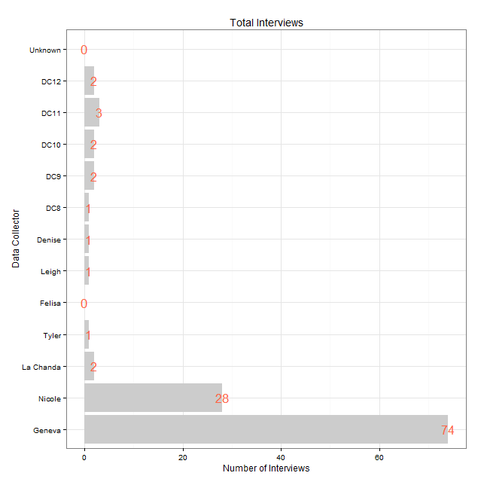
Example Report (Project Aggregate)

Slide 20
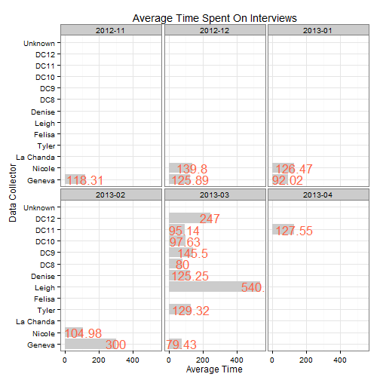
Example Report (6 Month History)

Slide 21
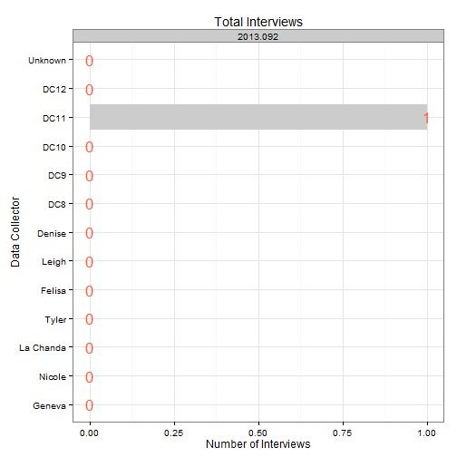
Example Report (7 Day History)

Slide 22
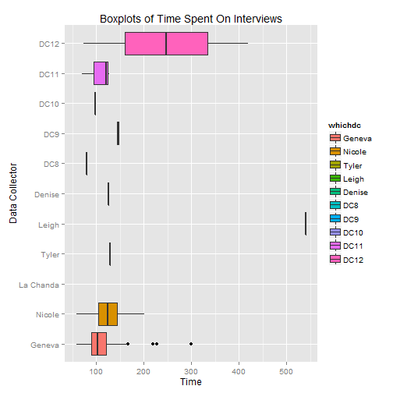
Example Report (Project Aggregate)

Slide 23
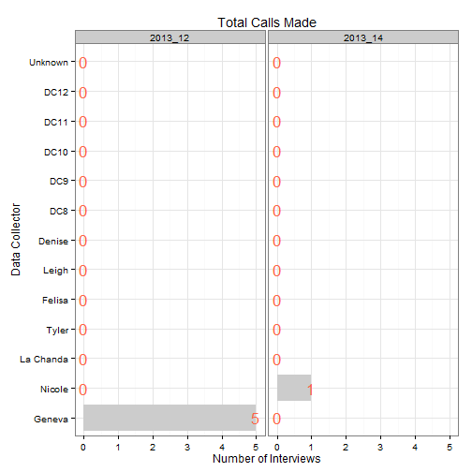
Example Report (4 Week History)

Slide 24
REDCap Advantages
Flexibility:
Productivity indicators established by project team
Reporting methods determined by project needs
All aspects are customizable
Current and historical reports
Automated:
Not necessary to compile data
Real-time data availability

Slide 25
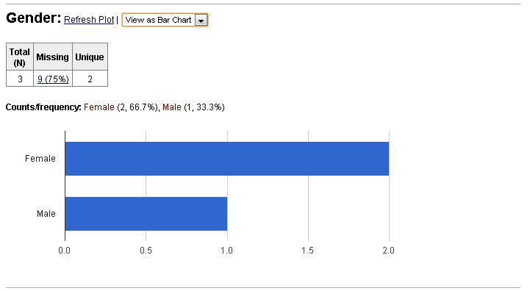
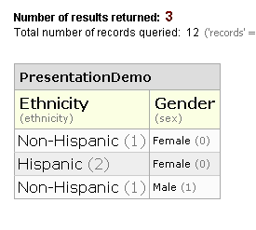
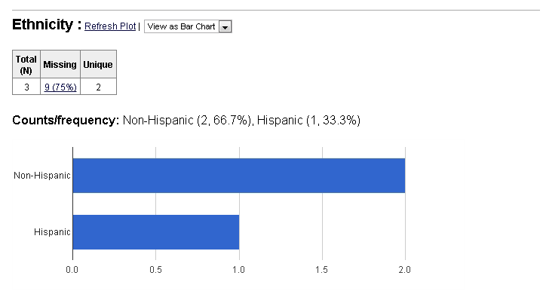
Reports for Outcomes: within REDCap
Accommodates basic descriptives & graphs, but not much more.

Slide 26
Reports for Outcomes: External to REDCap
Use automation to present results in a coherent document.
Eliminate the need to repeatedly copy & paste:
Multiple descriptives, graphs, and model results.
Updated results after more data trickles in.
Internal vs. External Audiences

Slide 27
Reports for Outcomes: Examples
Descriptives & graphs for internal audiences.
Tables for external audiences.
Text and Graphs for external audiences.
Optionally hosted online. https://github.com/OuhscCcanMiechvEvaluation/MReporting/blob/master/OhcaReports/OhcaReport1/OhcaReport1.md

Slide 28
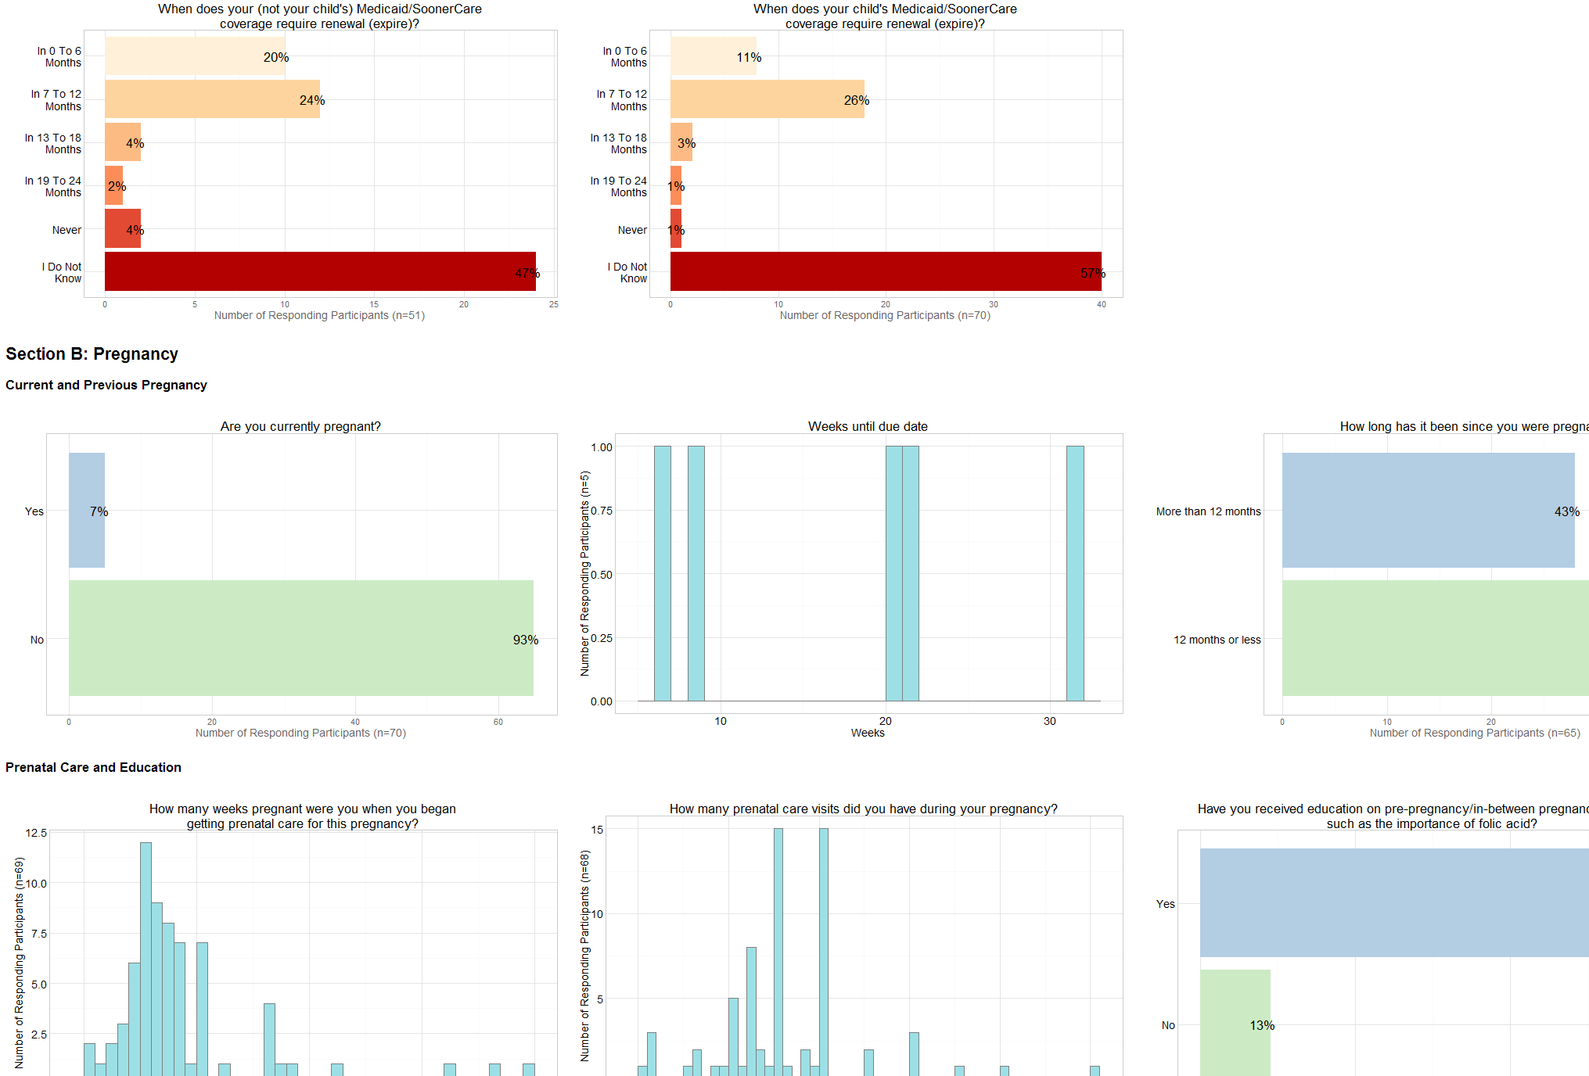
Quick for Internal Audiences

Slide 29
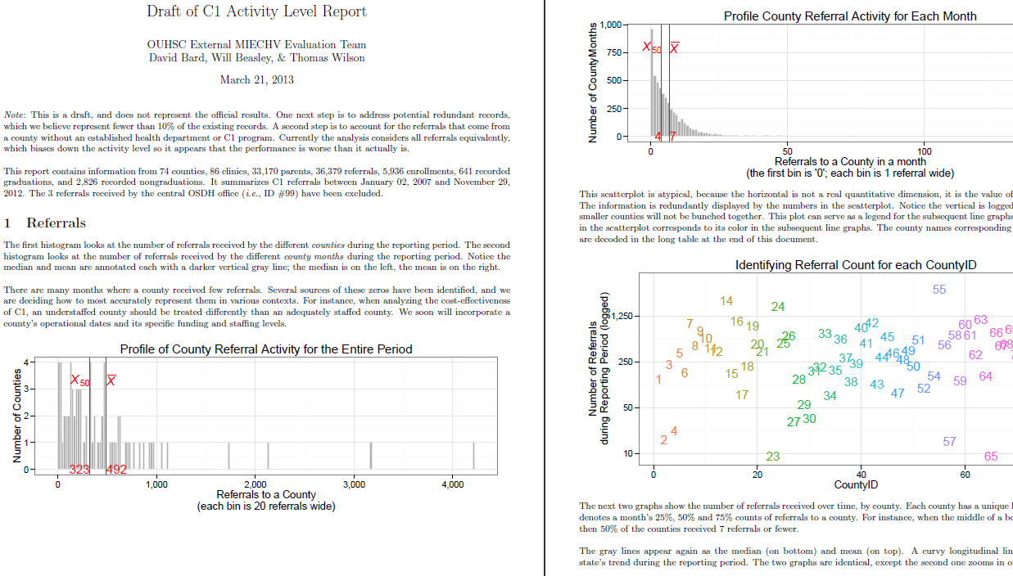
Text and Graphs for External Audiences

Slide 30
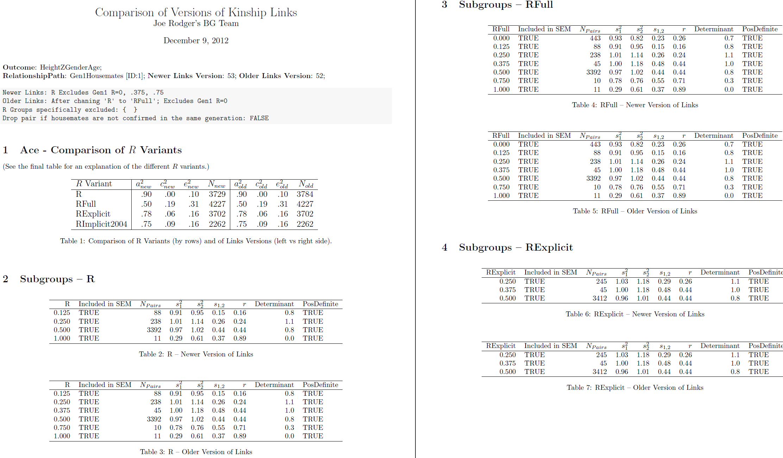
Tables for External Audiences

Slide 31
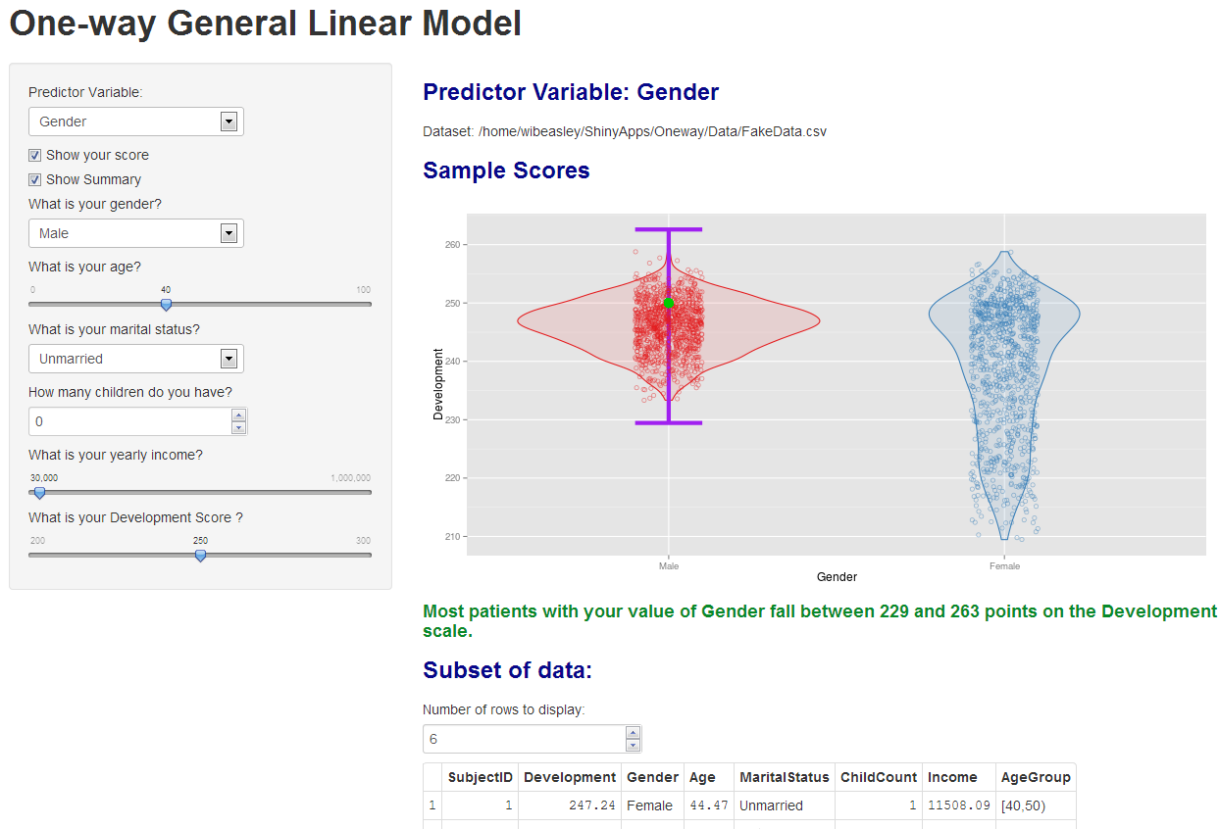
Quick for Internal Audiences

Slide 32
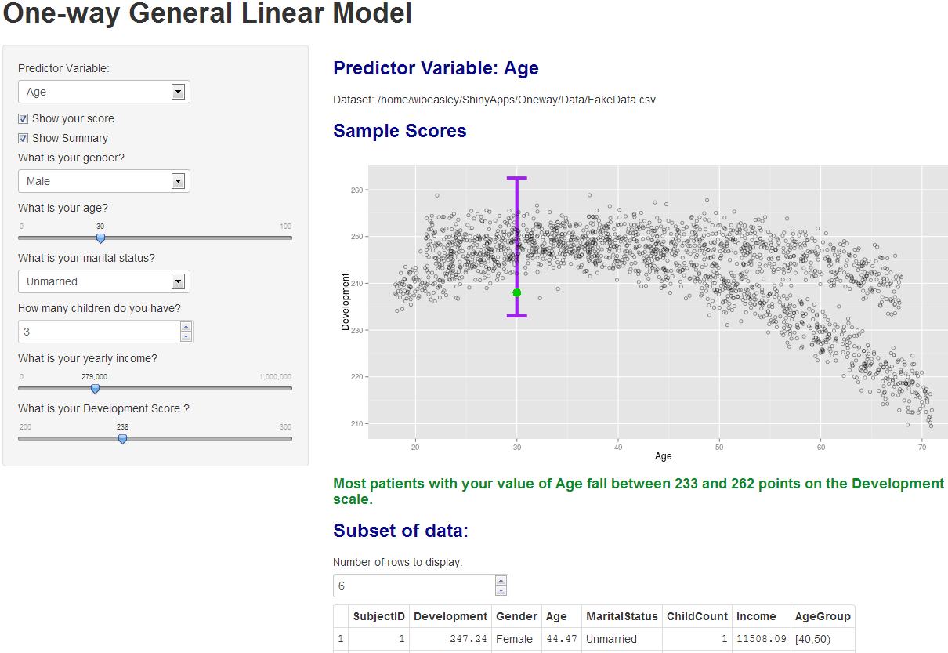
Quick for Internal Audiences

Slide 33
Goals
Reproducible research.
Facilitates scientific replication.
Disseminates techniques to other subfields.
Promotes cumulative research.
Literate programming.
Evaluated programs need fresh & frequent feedback.
Collaborative Development.

Slide 34
Collaboration among
The 4 statisticians on the project. sharing software development.
The 20 people on the project. exchanging participant-level data.
The 3 partnering organizations. (OSDH, WIC, OHCA) -receiving their subject-level & agency-level data. -distributing our results –fresh & frequently.
Academics in different areas. (particularly at OUHSC) exchanging tools and workflows.
Researchers in other states pursuing similar goals. publishing ideas and replicating previous work.

Slide 35
Document Version Control:
Examples: GitHub and Microsoft SharePoint
Think MS Word’s “Track Changes” feature, but
Retains the entire history of each document.
Facilitates parallel development between people.

Slide 36
Underlying Security Concepts Part 1
Principle of least privilege: expose as little as possible.
Limit the number of team members.
Limit the amount of data (consider rows & columns).
Obfuscate values and remove unnecessary PHI in derivative datasets.
Redundant layers of protection.
A single point of failure shouldn’t be enough to breach PHI security.

Slide 37
Underlying Security Concepts Part 2
Simplify when possible.
Store data in only two houses. (REDCap & SQL Server)
Easier to identify & manage than a bunch of PHI CSVs scattered across a dozen folders, with versions.
Manipulate your data programmatically, not manually.
Windows AD account controls everything, indirectly or directly. (VPN, Odyssey, file server, SQL Server, & REDCap)
Lock out team members where possible. It’s not that you don’t trust them with a lot of unnecessary data, it’s that you don’t trust their ex-boyfriend and their coffee shop hacker.

Slide 38
Presentation Outline
REDCap overview
Scenarios favoring REDCap
Reports for Project Management
Reports for Outcomes
Overall goals
Document Version Control
Security practices

Slide 40
Feature | REDCap | Qualtrics
Data Dictionary | Y | ?
Data Import | Y | n
Data Export & Summaries | Y | Y
E-mail survey | Only using a survey form, not a data collection form. | Y
Copy other surveys | Y | n
Survey templates | n | Y
Branching logic | Branching logic for individual Qs. | Branching for individual Qs and for groups of Qs.
Audio capabilities | Done via html | ?
Expiration capabilities: (eg, 1 week to respond) | n | Y
Spell check | n | Y
API | Y | n
Free to academic institutions | Y | n?
Offline data capture | Currently, there is not an official REDCap offline data capture component. However, CCAN has created an "in-house" off-line version of REDCap that is currently in use.
Our exposure to Qualtrics is limited. Please don’t interpret this as the authoritative guide.

